Slide 1
Unlocking Opportunities: Segmenting Customers for Breakfast Cuisine Success

Slide 2
Purpose of the Analysis
The purpose of this analysis is to segment existing customers based on their frequency and order value.
The primary objective is to identify valuable target groups for a marketing campaign focused on "Breakfast" cuisine.
The analysis and segmentation are based on provided data, which includes information about the cuisine, the value, the location of the order etc.
2

Slide 3
RFM Analysis for the Segmentation of the Data
We define 4 segments based on RFM Analysis, which are:
'Best Customers’ segment with Frequency score >= 2 & Recency score >= 2 & Monetary score >= 2
'Used to be loyal Customers’ segment with Frequency score >= 2 & Recency score <= 2
'One-time Customers’ segment with Frequency = 1 (number of orders)
‘Regular Customers’ segment with the remaining customers.
3

Slide 4
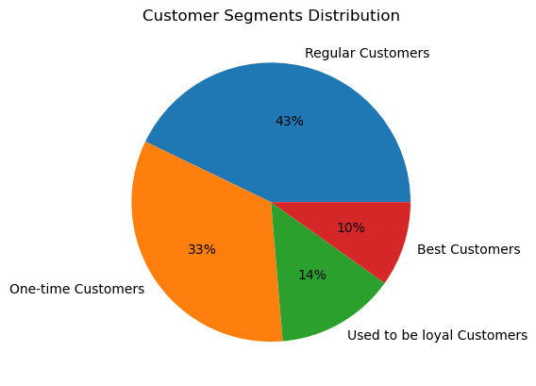
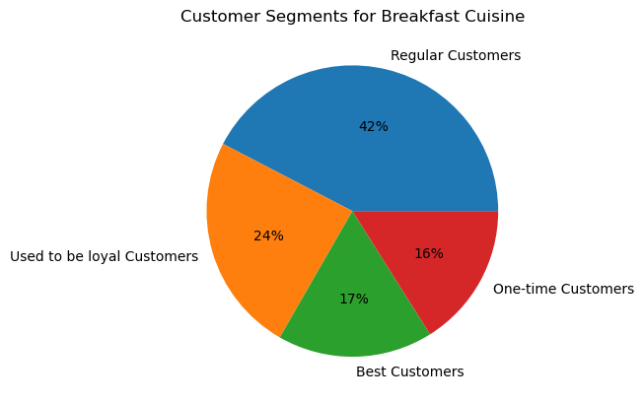
RFM Analysis for the Segmentation of the Data
4

Slide 5
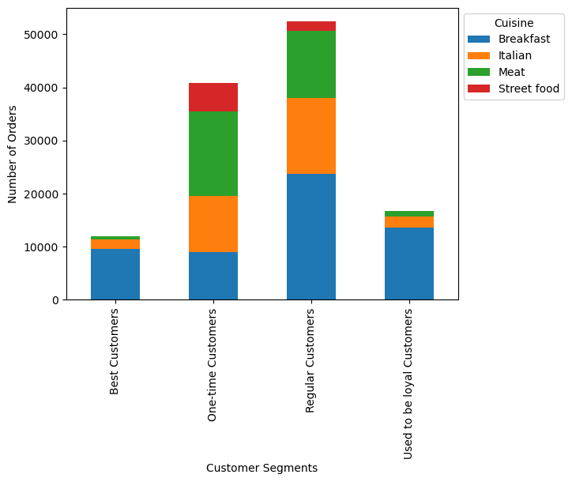
Cuisine Preference by Customers Segments
The target segment for the campaign is the ‘Regular Customers’ segment, representing a significant portion of the breakfast customers, but also among all the cuisines for this segment.
5

Slide 6
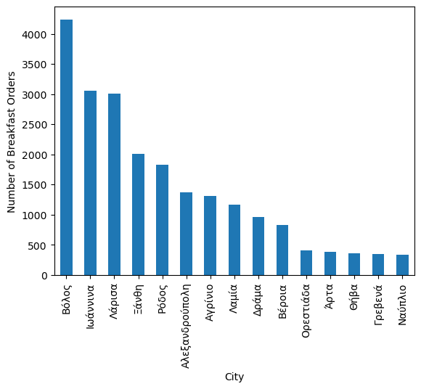
Number of Breakfast Orders by City
(‘Regular Customers’ Segment)
Βόλος has the highest number of breakfast orders for the ‘Regular Customers’ segment.
Ιωάννινα and Λάρισα show relatively lower number of breakfast orders compared to Βόλος, but still a high number.
6

Slide 7
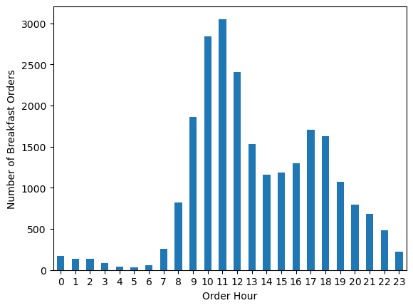
Distribution of Breakfast Orders by Order Hour (‘Regular Customers’ Segment)
We observe that the most amount of breakfast orders are around 10 to 11 am.
Also there are quite many orders at 12 pm.
7

Slide 8
Key Findings and Insights
The target segment for the campaign is the ‘Regular Customers’ segment, representing a significant portion of breakfast customers.
Cities such as Βόλος, Ιωάννινα and Λάρισα have high breakfast order volumes, presenting opportunities for targeted marketing efforts.
The distribution of breakfast orders by order hour highlights peak hours for breakfast orders, enabling optimized delivery and operational processes.
8

Slide 9
Marketing Campaign Recommendations
Personalized offers or promotions tailored to the ‘Regular Customers’ segment can incentivize repeat breakfast orders and enhance customer loyalty.
Collaborations with popular breakfast cuisine vendors can attract new customers and expand the customer base.
Focus on providing a seamless and convenient ordering and delivery process to enhance the overall customer experience.
9

Slide 10
Future Analysis and Data Considerations
Conduct an analysis of customer feedback and reviews specifically for breakfast cuisine orders to gain insights into customer preferences and satisfaction levels.
Explore the possibility of collecting demographic data to enable more granular customer segmentation and targeted marketing strategies.
Continuously monitor and analyze customer behavior and market trends to identify emerging opportunities and adapt marketing strategies accordingly.
10

Slide 11
Thank you for your time!
11

